Slide 1

Student Details
Name of the student: POTHULA TEJASRI
SKILLS BUILD email ID: yedukondalurao90@gmail.com
College name: GIET ENGINEERING COLLEGE
COLLEGE STATE: Andhra pradesh
INTERNSHIP DOMAIN: cybersecurity using kali linux
START DATE & END DATE: 03-06-2024 to 12-02-2024

Slide 2
Hiding a text inside an image using steganography
In the era of digital communication, ensuring secure transmission of sensitive information is crucial. Traditional encryption methods protect data during transit, but the existence of encrypted messages can still be detected. This project aims to explore the application of steganography as a covert communication technique by developing a system to hide textual information within digital images. The challenge lies in devising an efficient method to embed text into the pixel data of images without perceptible alteration to the visual quality of the image. The project will investigate different steganographic techniques, evaluate their effectiveness in terms of hiding capacity and robustness against detection, and develop a software tool that can reliably embed and extract text messages from images
An officer in danger requires a method to send a secret text message without alerting nearby criminals to his higher officials. Traditional communication methods are easily intercepted or monitored, so, he his necessitating a covert technique to embed and transmit critical information securely to his higher officials.

Slide 3
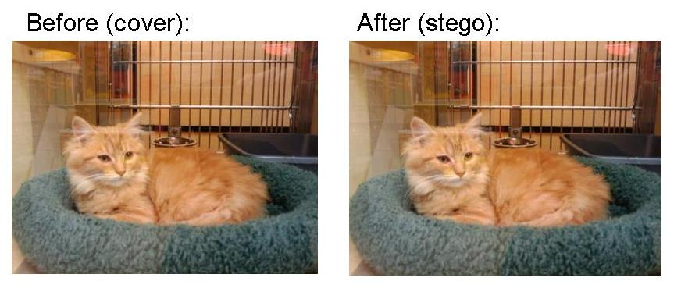
AGENDA
The agenda of this project to send a secret text to higher officials using the steganography concept and RGB technique, ensuring that criminals or others cannot identify the image or its hidden content. This project will involve encoding the secret text into the least significant bits of the image’s pixels, making the alterations imperceptible to the human eye. Additionally, a secure key-based XOR operation will be used to enhance the security of the hidden message. Finally, the project will include a robust mechanism for decoding and retrieving the hidden message, ensuring that only authorized personnel with the correct key can access the concealed information.

Slide 4
PROJECT OVERVIEW
This project implements a steganography technique to securely hide and reveal secret within an image using the RGB color mechanism and a key based XOR operation for encryption. Steganography allows for concealing messages within non-secret text or data, ensuring secure communication by embedding sensitive information within an image in a way that is imperceptible to unauthorized viewers.
Image Encoding: Secret text is hidden within the image’s pixel values using the LSB method, with additional security provided by XOR the text characters with a user-provided security key.
Pixel Manipulation: The encoded text is distributed across the image’s pixels, maintaining the visual integrity of the image while embedding the hidden message.
Text Decoding: The project includes functionality to decrypt and retrieve the hidden text from the image using the correct security key, ensuring that only authorized users can access the information.
This project demonstrates a practical application of steganography for secure communication, embedding and retrieving secret messages within images in a secure and efficient manner.

Slide 5

WHO ARE THE END USERS of this project?
The primary end users for this steganography project include government and military personnel secure communication, corporate executives protecting proprietary data, and journalists sharing sensitive information discreetly.
IT and cyber security teams can integrate this technique to enhance organizational data security.
Additionally, the person who wants to send any secret message other person in a hidden format then this project will helpful for them.
Steganography can be employed to embed copyright information or digital watermarks within images to assert ownership and deter unauthorized use or distribution.

Slide 6
YOUR SOLUTION AND ITS VALUE PROPOSITION
.
Steganography is the basic concept to hide the data inside other data.
In this project RGB Mechanism is used for pixel manipulation.
XOR operation is used for encryption and decryption of the test inside the image.
The project reads an image and hides the secret text within the pixel values using the least significant bits (LSB) method.
For security purpose that means to avoid unauthorized users taking the advantage of the message, a secret key used to hide and unhide the data.
Finally, By using this project we can hide the data inside an image using secret key and for unhide the message secret is used.

Slide 7
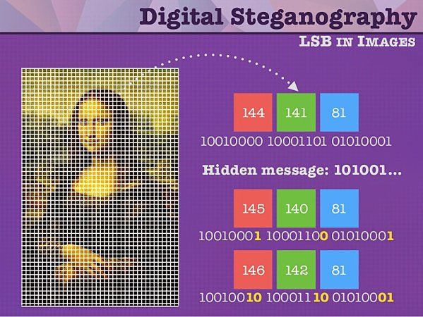
How did you customize the project and make it your own
To customize and make this steganography project my own, I focused on implementing the RGB technique with XOR operation for embedding and extracting text within digital images. This approach not only ensures that the hidden text is integrated seamlessly into the image's pixel data but also enhances the security by using XOR encryption. By leveraging XOR operation, the project aims to provide a balance between simplicity and effectiveness in concealing information, making it suitable for applications requiring covert communication and data protection. Through rigorous testing and optimization of the algorithm, I aim to deliver a robust steganography tool that meets the needs of users in sectors such as journalism, cybersecurity, and personal privacy, offering a reliable solution for secure digital communication.

Slide 8
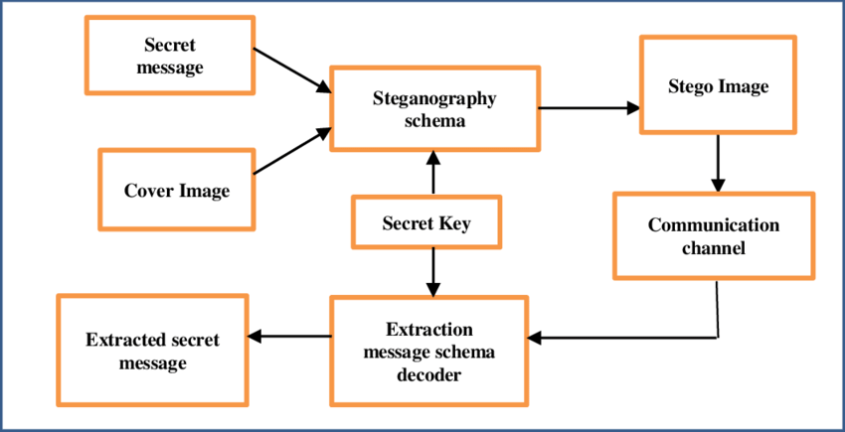
MODELLING
Step 1: Import the libraries like cv2 and os for accessing relevant concept into code.
Step 2: After converting the text into their equivalent ASCII values that values should be stored in the variables.
Step 3: Read the image from it’s path and hiding the image using XOR operation , RGB mechanism
Step 4: A secret key should be generated to avoid unauthorized users.
Step 5: To unhide the image user need to know the secret key .
Step 6: Then the user can able to see the secret message.

Slide 9
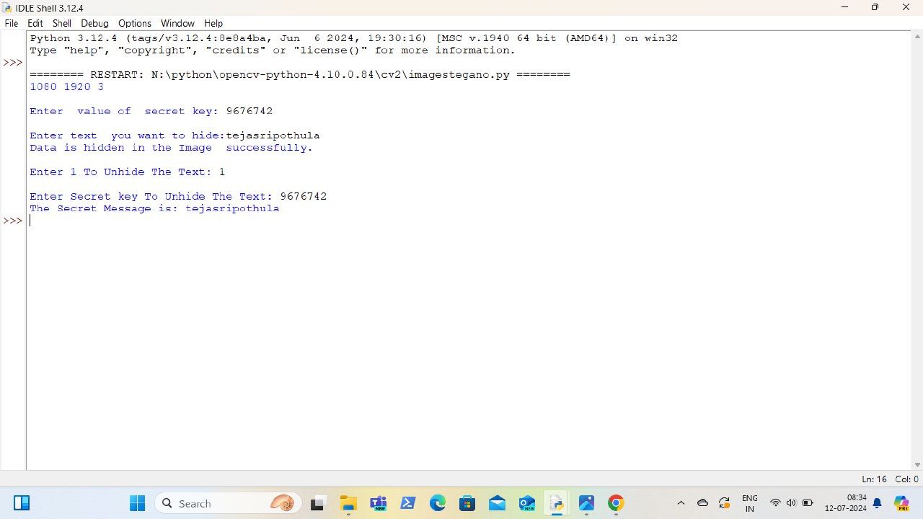
Results

Slide 10

ORIGINAL IMAGE:

Slide 11

ENCRYPTED IMAGE:

Slide 12
links
https://github.com/Teja290604/Image_stege.git

